Slide 1
GENERATIVE NEUROLOGIST

Slide 2
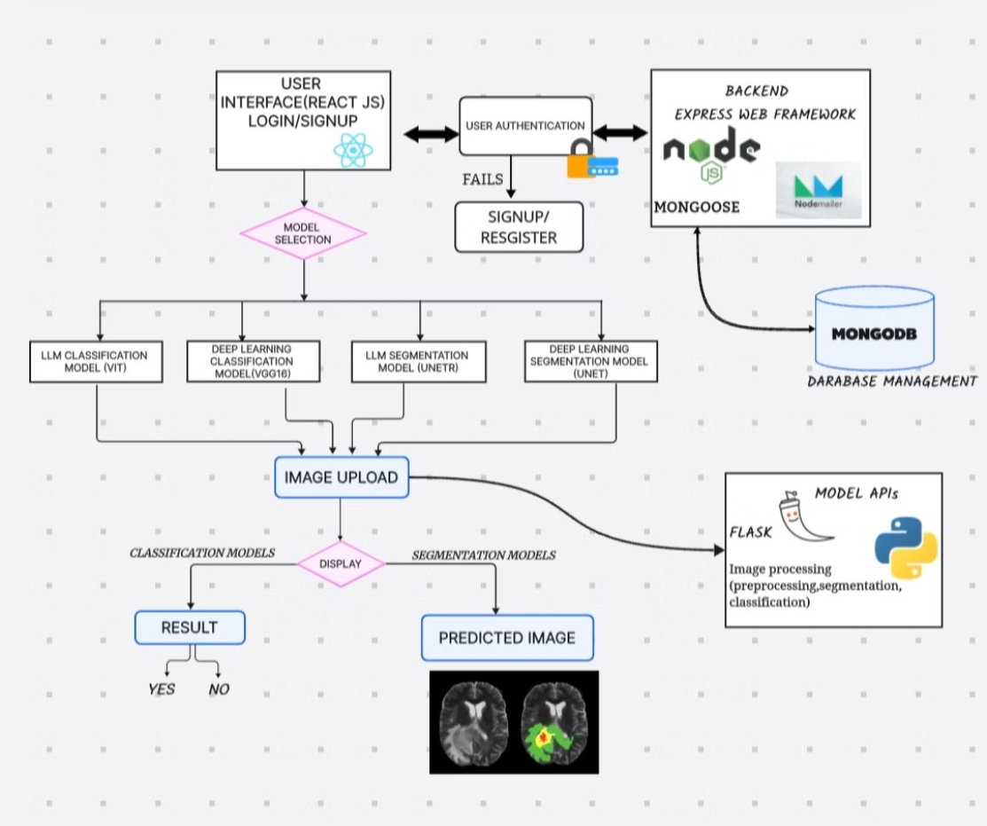
WORK FLOW

Slide 3
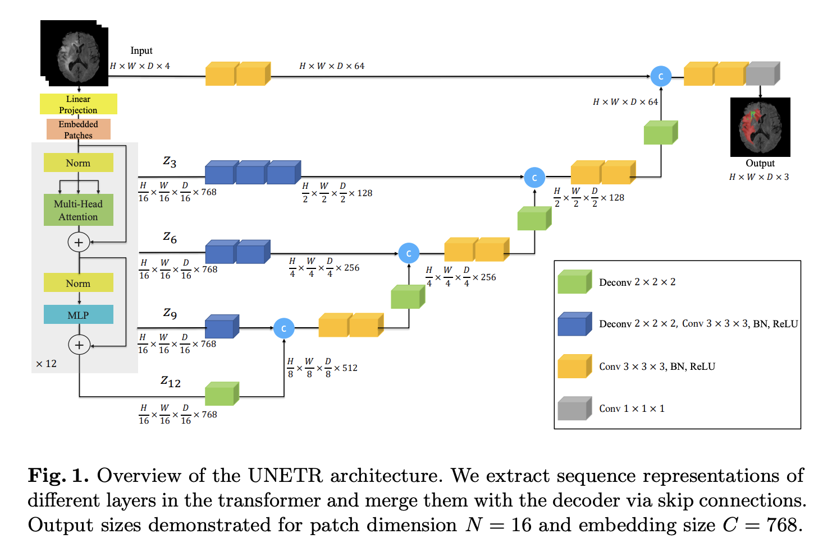
INTRODUCTION TO UNETR
UNETR (UNet Transformer) is a novel deep learning model that combines the strengths of the U-Net architecture with Transformer-based encoders.
It is designed for 3D medical image segmentation but it can also used for 2D offering improved accuracy by capturing global context and long-range dependencies.
This hybrid approach enhances performance in tasks like tumor segmentation, making it significant in medical imaging.

Slide 4
AGENDA
WORK FLOW
Large Language Model
Segmentation using UNETR
Classification using VITs
Deep Learning Model
Segmentation using UNET
Classification using VGG16

Slide 5
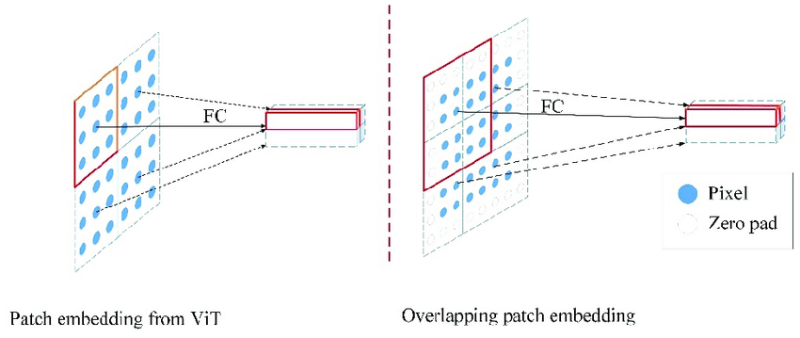
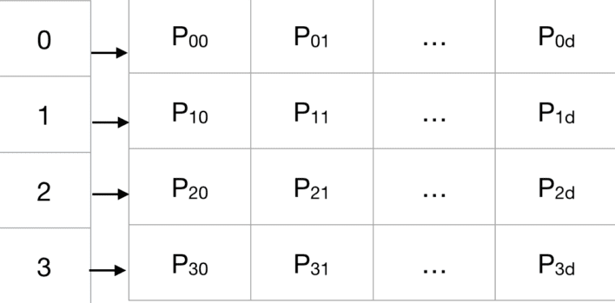
PATCH & POSITOIN EMBEDDING
Patch embedding:
A patch embedding layer maps patches of pixels to vectors by dividing an input image into fixed-size patches, flattening them, and linearly projecting them into a higher-dimensional space.
PatchEmbedding = FlattenedPatch⋅W+b
Position embedding:
positional embeddings are order or positional identifiers added to the original embedding vectors for the transformer architecture to incorporate the order of the sequence
PosEmbedding[i]=TrainableParameter[i]
Patch embedding
Position embedding

Slide 6


MULTILAYER PERCEPTRON
Feed forward propagation
z=$X_{(d,inp)}∗W_{(d_{inp},d_{out})}$+$b_{d_{out}}$
${Z_{1,3072}=X}_{1,256∗768}$*$W_{256∗768,3072}+b_{\begin{aligned}3072 \\ \end{aligned}}$
Activation function
GELU(x)≈0.5x(1+tanh(√2/π​​(x+0.044715x^3)))
Loss function
Backward propagation

Slide 7
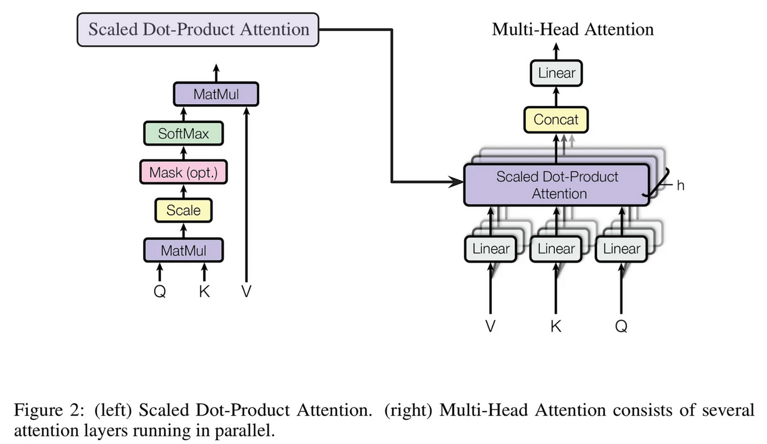

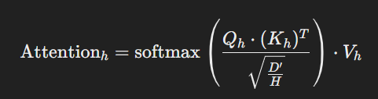
MULTI HEAD ATTENTION
Multi-head attention is a mechanism used in transformer-based architectures, designed to enhance the model's ability to focus on different parts of the input data simultaneously.
QKV
Query (Q): used to represent what to attend to in other parts of the image.
Key (K): used to represent the relationship between the current patch and other patches.
Value (V): contain information that will be combined according to the attention weights.

Slide 8
Convolution & Deconvolution blocks
Convolution layer:
the convolution layer extracts features by sliding a filter over input image patches.
This layer captures local patterns and prepares data for further processing by transformer blocks.
o/p=[(ip_size - kernel_size+2padding layers)/stride]
convolution
Deconvolution Layer:
A deconvolution block is a network component used for increasing the spatial resolution of feature maps.
It performs upsampling by learning to reconstruct finer details from lower-resolution inputs
Deconvolution

Slide 9
Thank you

Slide 10
GENERATIVE NEUROLOGIST

Slide 11
AGENDA
INTRODUCTION TO UNETR
PATCH AND POSITION EMBEDDING
ARCHITECTURE OF UNTER
TRANSFORMER
MULTI HEAD ATTENTION
MULTI LAYER PERCEPTRON
CONVOLUTION BLOCKS
DECONVOLUTION BLOCKS

Slide 12
WORK FLOW

Slide 13
INTRODUCTION TO UNETR
UNETR (UNet Transformer) is a novel deep learning model that combines the strengths of the U-Net architecture with Transformer-based encoders.
It is designed for 3D medical image segmentation but it can also used for 2D offering improved accuracy by capturing global context and long-range dependencies.
This hybrid approach enhances performance in tasks like tumor segmentation, making it significant in medical imaging.

Slide 14
PATCH & POSITOIN EMBEDDING
Patch embedding:
A patch embedding layer maps patches of pixels to vectors by dividing an input image into fixed-size patches, flattening them, and linearly projecting them into a higher-dimensional space.
PatchEmbedding = FlattenedPatch⋅W+b
Position embedding:
positional embeddings are order or positional identifiers added to the original embedding vectors for the transformer architecture to incorporate the order of the sequence
PosEmbedding[i]=TrainableParameter[i]
Patch embedding
Position embedding

Slide 15

MULTILAYER PERCEPTRON
Feed forward propagation
z=$X_{(d,inp)}∗W_{(d_{inp},d_{out})}$+$b_{d_{out}}$
${Z_{1,3072}=X}_{1,256∗768}$*$W_{256∗768,3072}+b_{3072}$
Activation function
GELU(x)≈0.5x(1+tanh(√2/π​​(x+0.044715x^3)))
Loss function
Backward propagation

Slide 16
MULTI HEAD ATTENTION
Multi-head attention is a mechanism used in transformer-based architectures, designed to enhance the model's ability to focus on different parts of the input data simultaneously.
QKV
Query (Q): used to represent what to attend to in other parts of the image.
Key (K): used to represent the relationship between the current patch and other patches.
Value (V): contain information that will be combined according to the attention weights.

Slide 17
Convolution & Deconvolution blocks
Convolution layer:
the convolution layer extracts features by sliding a filter over input image patches.
This layer captures local patterns and prepares data for further processing by transformer blocks.
o/p=[(ip_size - kernel_size+2padding layers)/stride]
convolution
Deconvolution Layer:
A deconvolution block is a network component used for increasing the spatial resolution of feature maps.
It performs upsampling by learning to reconstruct finer details from lower-resolution inputs
Deconvolution

Slide 18
Thank you

